Slide 1
 |  | A | B | C | D | E | F | G | H
 | 0 | 0 | 0 | 0 | 0 | 0 | 0 | 0 | 0 | 0
1 | 0 | 2 | 2 | 2 | 2 | 2 | 2 | 2 | 2 | 0 | 1
2 | 0 | 2 | 2 | 2 | 2 | 2 | 2 | 2 | 2 | 0 | 2
3 | 0 | 2 | 2 | 2 | 2 | 2 | 2 | 2 | 2 | 0 | 3
4 | 0 | 2 | 2 | 2 | 1 | -1 | 2 | 2 | 2 | 0 | 4
5 | 0 | 2 | 2 | 2 | -1 | 1 | 2 | 2 | 2 | 0 | 5
6 | 0 | 2 | 2 | 2 | 2 | 2 | 2 | 2 | 2 | 0 | 6
7 | 0 | 2 | 2 | 2 | 2 | 2 | 2 | 2 | 2 | 0 | 7
8 | 0 | 2 | 2 | 2 | 2 | 2 | 2 | 2 | 2 | 0 | 8
 | 0 | 0 | 0 | 0 | 0 | 0 | 0 | 0 | 0 | 0
 |  | A | B | C | D | E | F | G | H

Slide 2
u
Jeu
Solo
IA
MultiJoueurs
Othello
Intelligence Artificielle
Damier
Damier Evaluation
Joueur

Slide 3
Fenêtre
Jeu
u
MultiJoueurs
Solo
IA
Othello
Intelligence Artificielle
Damier
Damier Evaluation
Joueur

Slide 4
 | A | B | C | D | E | F | G | H
1 | 500 | -150 | 30 | 10 | 10 | 30 | -150 | 500 | 1
2 | -150 | -250 | 0 | 0 | 0 | 0 | -250 | -150 | 2
3 | 30 | 0 | 1 | 2 | 2 | 1 | 0 | 30 | 3
4 | 10 | 0 | 2 | 16 | 16 | 2 | 0 | 10 | 4
5 | 10 | 0 | 2 | 16 | 16 | 2 | 0 | 10 | 5
6 | 30 | 0 | 1 | 2 | 2 | 1 | 0 | 30 | 6
7 | -150 | -250 | 0 | 0 | 0 | 0 | -250 | -150 | 7
8 | 500 | -150 | 30 | 10 | 10 | 30 | -150 | 500 | 8
 | A | B | C | D | E | F | G | H

Slide 5
N
NE
NO
E
pp
O
SE
SO
S

Slide 6
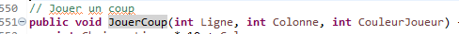

Slide 7
Max
2
Min
0
?

Slide 8
Min
0
Max
2
?

Slide 9
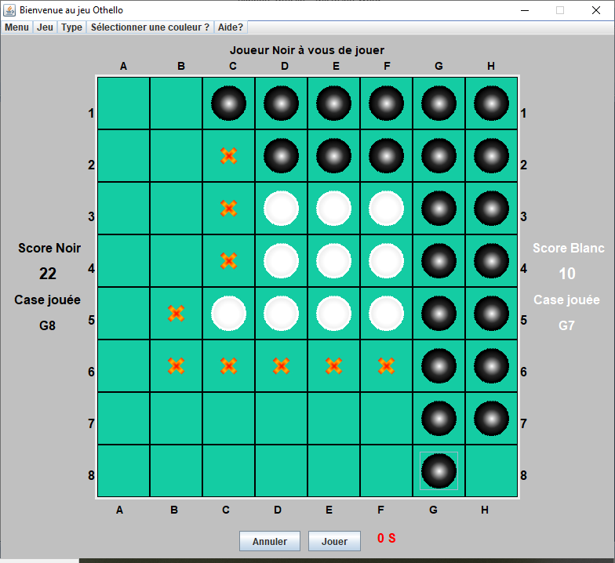

Slide 10
 | A | B | C | D | E | F | G | H
1 | 500 | -150 | 250 | 250 | 250 | 250 | 250 | 500 | 1
2 | -150 | -250 | 0 | 250 | 250 | 250 | 250 | 250 | 2
3 | 30 | 0 | 1 | 2 | 2 | 1 | 250 | 250 | 3
4 | 10 | 0 | 2 | 16 | 16 | 2 | 250 | 250 | 4
5 | 10 | 0 | 2 | 16 | 16 | 2 | 250 | 250 | 5
6 | 30 | 0 | 1 | 2 | 2 | 1 | 250 | 250 | 6
7 | -150 | -250 | 0 | 0 | 0 | 0 | -250 | 250 | 7
8 | 500 | -150 | 30 | 10 | 10 | 30 | -150 | 500 | 8
 | A | B | C | D | E | F | G | H

Slide 11
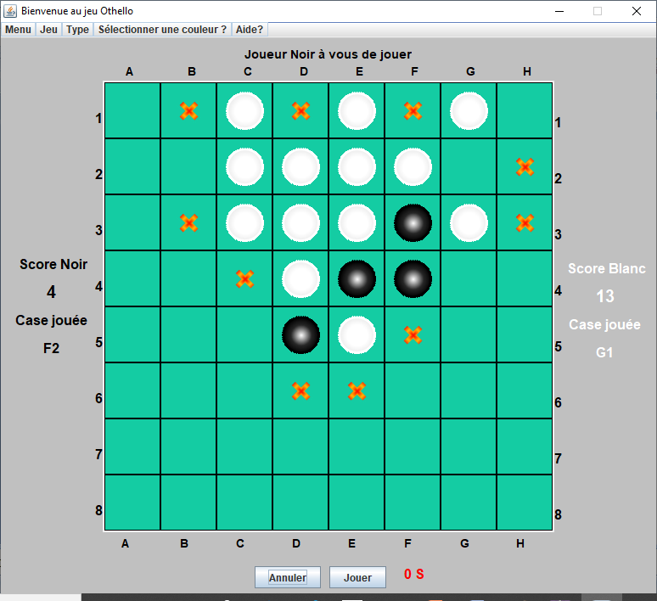

Slide 12
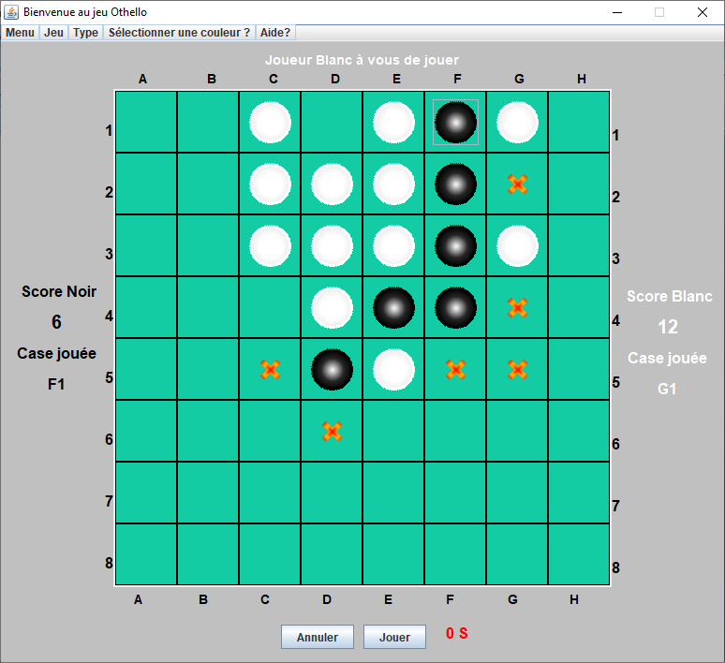

Slide 13
 | A | B | C | D | E | F | G | H
1 | 500 | -150 | 30 | 10 | 500 | 150 | 750 | 500 | 1
2 | -150 | -250 | 0 | 0 | 0 | 0 | -250 | -150 | 2
3 | 30 | 0 | 1 | 2 | 2 | 1 | 0 | 30 | 3
4 | 10 | 0 | 2 | 16 | 16 | 2 | 0 | 10 | 4
5 | 10 | 0 | 2 | 16 | 16 | 2 | 0 | 10 | 5
6 | 30 | 0 | 1 | 2 | 2 | 1 | 0 | 30 | 6
7 | -150 | -250 | 0 | 0 | 0 | 0 | -250 | -150 | 7
8 | 500 | -150 | 30 | 10 | 10 | 30 | -150 | 500 | 8
 | A | B | C | D | E | F | G | H

